Slide 1
Walking Together First Nations, Métis and Inuit Perspectives in Curriculum
A Professional Development Resource
Notes:
This resource is response to calls for support in weaving First Nation, Métis and Inuit content, perspectives and experiences into the Alberta curriculum.
This resource is intended to be used by teachers, administrators, parents/guardians and stakeholders in enhancing their knowledge and understanding of First Nation, Métis and Inuit content, perspectives and experiences.

Slide 2
Walking Together First Nations, Métis and Inuit Perspectives in Curriculum
An Introduction
Notes:
This resource will provide a working foundation of First Nation, Métis and Inuit topics, issues, cultures and ways of knowing.
Throughout the resource are personally meaningful perspectives and experiences from members of various First Nation, Métis and Inuit communities across Alberta.
The contributing members truly wanted to share their knowledge, experiences and wisdom in a spirit of enhancing the education of their children and grandchildren.
However, it is important to point out that the weaving of First Nation, Métis and Inuit content, perspectives and experiences into learning experiences is intended to enhance the education of ALL children in Alberta.

Slide 3
A Professional Development Resource
Notes:
Each piece of the resource has been carefully formulated and designed to reflect Indigenous teachings and perspectives:
Stones
The stones are used as navigation buttons to the topic areas.
Circle
The circle indicates that all things are equal and that we share our world with others.
The circle of stones can be connected to the medicine wheels and tipi rings found across Alberta indicating that the knowledge shared is from the land.
Rocks and stones carry story and information, in both a figurative and literal sense, as they are considered to be the “old ones” who pass knowledge on to those who have the gift to see and hear their stories.
Leather Header
The leather header located on all of the resource pages is a motif used with ethno culturally-inspired pictographs.
The pictographs visually acknowledge and honour tradition in this contemporary and technological setting. These glyphs, inspired by those found at Writing-on-Stone Provincial Park, were created by Albertan artist Elizabeth Jean Tait specifically for this resource.

Slide 4
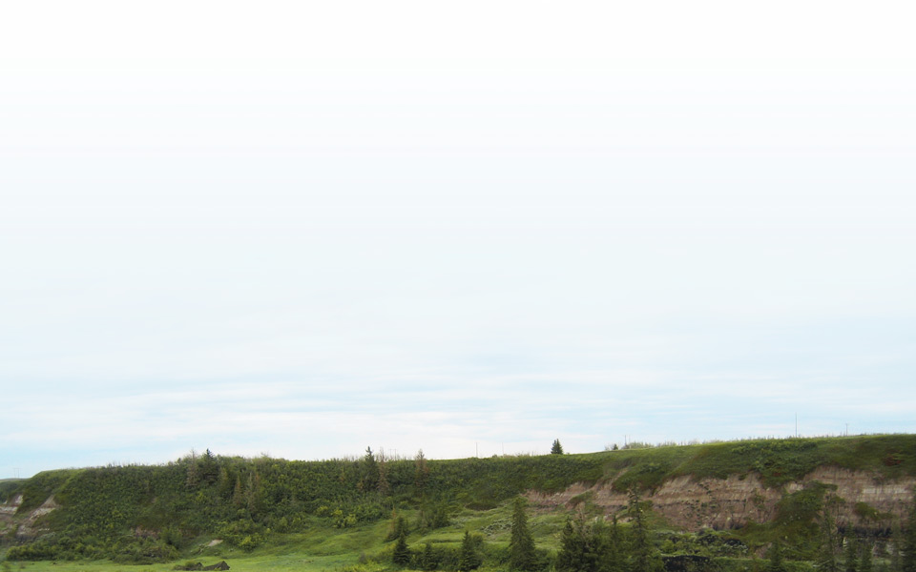
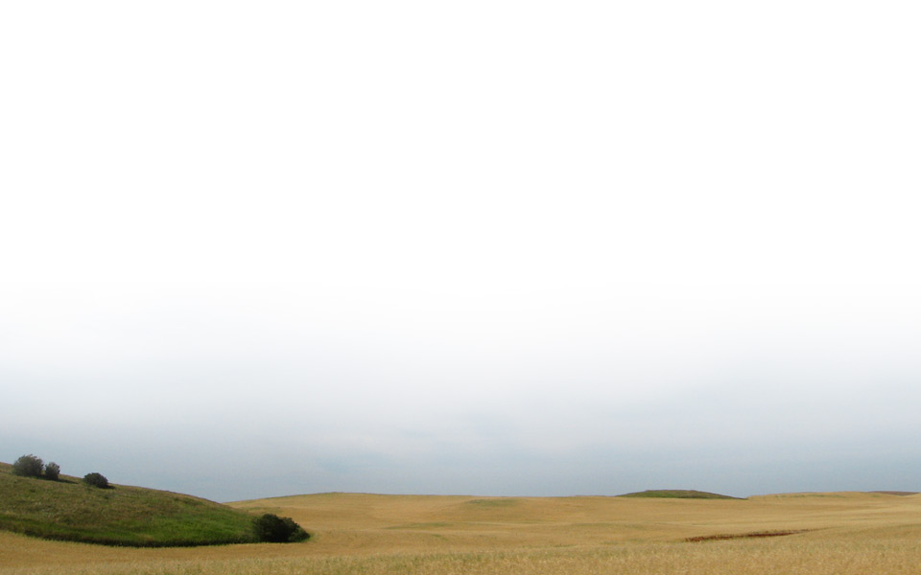
Notes:
Background
Images are actual photos of Alberta landscapes and places. They honour the diversity of First Nations, Métis and Inuit in a traditional way while acknowledging contemporary times.
Home page images are indicative of the four directions and convey a sense of knowledge and respect for all, creating a meaningful relationship between the resource itself and the users through the interface. The home page background scenes are designed to change seasonally.

Slide 5
Notes:
The 12 topic areas are derived from those suggested at the initial community meetings.
These topic areas were chosen through direct consultation with First Nation, Métis and Inuit focus groups and stakeholders.
While the resource is presented as 12 topics, each topic area is connected to the others in many ways and on many levels.
To reflect Indigenous pedagogy, it is highly recommended that participants begin their exploration with Worldviews and proceed in a clockwise fashion.
This resource is intended to be used by teachers, administrators, parents/guardians and stakeholders in enhancing their knowledge and understanding of First Nation, Metis and Inuit content, perspectives and experiences. This resource is response to calls for support in weaving First Nation, Metis and Inuit content, perspectives and experiences into the Alberta curriculum.
Throughout the resource are personally meaningful perspectives and experiences from members of various First Nation, Metis and Inuit communities across Alberta.
The contributing members truly wanted to share their knowledge, experiences and wisdom in a spirit of enhancing the education of their children and grandchildren.
However, it is important to point out that the weaving of First Nation, Métis and Inuit content, perspectives and experiences into learning experiences is intended to enhance the education of ALL children in Alberta.

Slide 6
Notes:
The Beginning Together section of each topic area presents an educational scenario as a way of introducing the topic area. Many of the scenarios are interactive.
Review the navigational features of page.

Slide 7
Notes:
Respecting Wisdom features first-voice interviews with prominent Elders, Knowledge Keepers and culture experts from communities across Alberta.
Navigation features include the
name of the speaker and his or her affiliation
video screen window and displays a description of the interview as well as the duration of the video
location map that displays the home community of the speaker with a white dot and label (The dark dot and label indicate the community within which the individual works, such as an urban area.)

Slide 8
Notes:
Observing Practice section provides a video illustrating the topic area under investigation.
Navigational features:
The videos display panel features, such as a time counter, sound volume and full-screen viewing. Videos include chapter descriptions, which also allow the viewer to move to different chapters.
The location map indicates the location of the event and is visible where applicable.

Slide 9
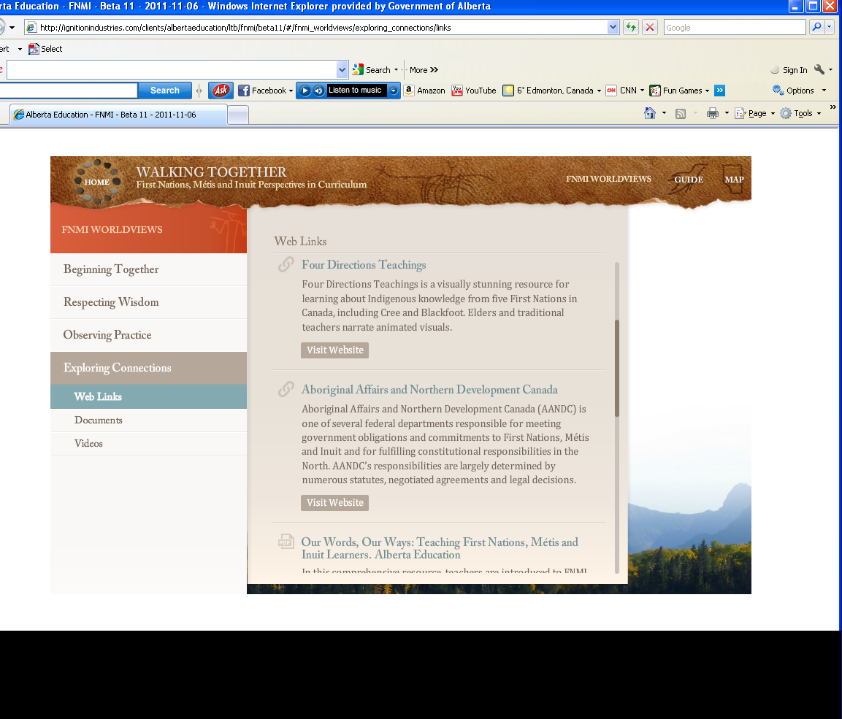
Notes:
Exploring Connections provides access to resources such as web links, documents and videos. The Web Links area provides access to quality resources from other organizations, including comprehensive resources from Alberta Education and the ATA.

Slide 10
Notes:
The Documents area provides access to PDF documents that can be read on-screen or printed for future reference. The documents include scholarly papers, articles and excerpts from resources used in Aboriginal Studies 10-20-30.

Slide 11
Notes:
Videos specific to this resource reside outside the LearnAlberta.ca firewall and are accessible with sign in.
Commercial videos require additional login to the LearnAlberta.ca site, which is indicated by the padlock icon.
These videos share the same navigational features as those videos in the Observing Practice sections.

Slide 12
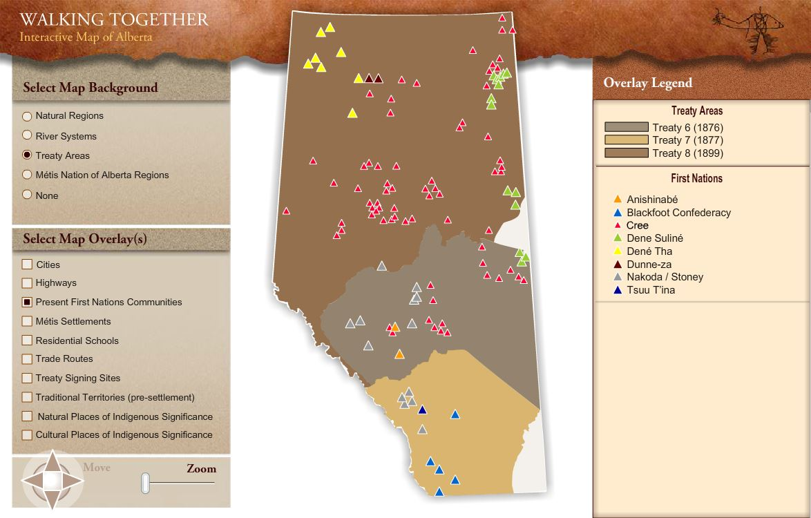
Notes:
Click on the map, it is hyperlinked to the web page.
The purpose of this Interactive Map is to link its users directly to their own personal connection with the land on which they reside.
As one becomes more familiar with the resource, the Interactive Map will become a valued tool in specifying location.

Slide 13
Notes:
The Talking Together discussion guide provides an overview of the resource, a comprehensive index to Walking Together, as well as workshops, promotional messages and activities suitable for one-hour staff meetings.

Slide 14
The resource is accessible through:
http://www.learnalberta.ca/content/aswt/index.html
Notes:
The resource is accessible through the displayed URL.

